Slide 1
Distributed computing through Apache Spark - An Example with Spark, SparkML and SparkNLP.
Chandra Sekhar Saripaka

Slide 2
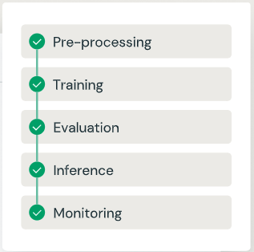
Know Hows
Basic Technical Analysis ( Know your data )
Exploratory Data Analysis ( EDA - If needed.)
Deciphering your data. ( Know your columns and rows )
Pre-Processing ( Drop all Na’s , Nulls and Junk Values which dont make sense )
Train / Test
Inference
Summary
Deployment
Scaling
Results
Visualization

Slide 3
Approach
Basic understanding of spark
Distributed computing Concepts in Spark
Hands on with some spark read and write examples
Introduction to ML in Spark
Scikit-Learn scaling with Spark.
Introduction to SparkNLP and MLPipelines
Use Logistic Regression with Count and TFIDF vectorizer
Use Naive Bayes with Count and TFIDF vectorizer

Slide 4
Apache Spark
Fast and Expressive Cluster Computing Engine Compatible with Apache Hadoop , Object Store, S3 and Many more file systems.
Up to 10× faster on disk, 100× in memory
2-5× less code
Efficient & Usable
General execution graphs
In-memory storage
Rich APIs in Java, Scala, Python, R
Interactive shell
Generalize the map/reduce framework

Slide 5
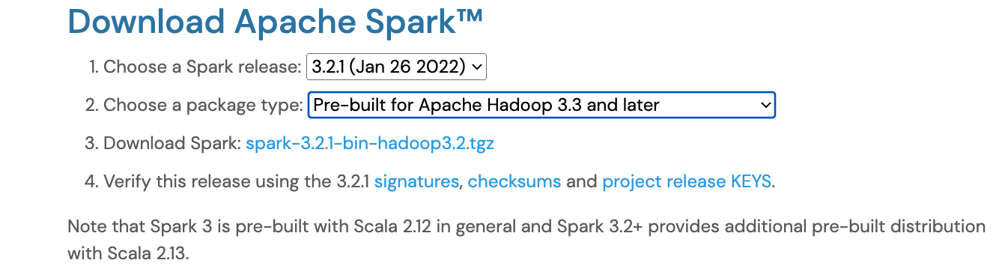
Spark - How to Setup
Run Locally - Using local[*]
Run remotely - on AWS , Azure, GCP
Download spark latest version - with or without Hadoop

Slide 6
Spark - How to Run
Spark - Many Ways to Run.
Spark-Shell
Spark-SQL
Pyspark
Jupyter Note-book
Spark-Submit to package as jar and run.
JobServer
$ spark-shell --packages com.johnsnowlabs.nlp:spark-nlp_2.12:3.4.2
$ pyspark --packages com.johnsnowlabs.nlp:spark-nlp_2.12:3.4.2
$ spark-submit --packages com.johnsnowlabs.nlp:spark-nlp_2.12:3.4.2
$ spark-shell --jars spark-nlp-assembly-3.4.2.jar

Slide 7
pyspark
# install pyspark
pip install --upgrade pyspark
# get pyspark help
pyspark --help
# invoke pyspark interactive shell
pyspark
# or through python or ipython
ipython
>> import pyspark

Slide 8
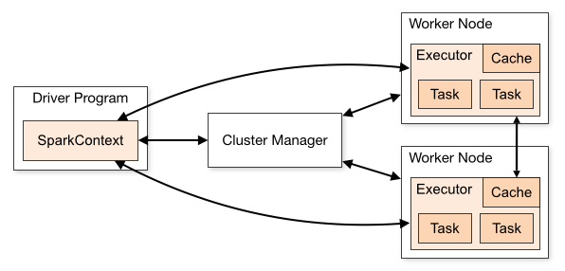
Spark Clustering & Distributed Processing
Standalone — a simple cluster manager included with Spark that makes it easy to set up a cluster.
Apache Mesos — a general cluster manager that can also run Hadoop MapReduce and service application.
Hadoop YARN — the resource manager in Hadoop 2
Kubernetes — an open-source system for automating deployment, scaling, and management of containerized applications

Slide 9
Differences between Spark and Pandas
Spark
Lazy Execution
Spark avoid pulling the full data frame into memory
Compatible with large datasets.
Spark does Parallel processing by taking advantage of partitions
Pandas
Eager Execution
Pandas operate by fully pulling the dataframe into the memory.
Not Compatible with large datasets.
Pandas won't do the parallelization , executed in the same memory.

Slide 10
spark-submit
./bin/spark-submit \
--class <main-class> \
--master <master-url> \
--deploy-mode <deploy-mode> \
--conf <key>=<value> \
... # other options
<application-jar> \
[application-arguments]
--class: The entry point for your application (e.g. org.apache.spark.examples.SparkPi)
--master: The master URL for the cluster
--deploy-node: cluster or client ( default )
--conf: Spark configuration property in "key=value" format.
application-jar: Path to a bundled jar , For instance, an hdfs:// path or a file:// path that is present on all nodes.
application-arguments: Arguments passed to the main method of your main class, if any

Slide 11
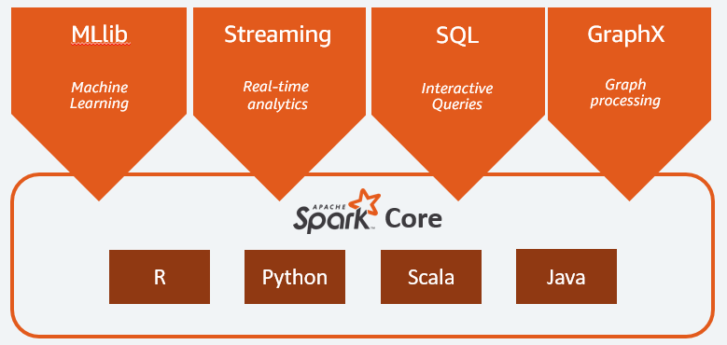
Spark Blocks
Ref: https://towardsdatascience.com/apache-spark-a-conceptual-orientation-e326f8c57a64

Slide 12
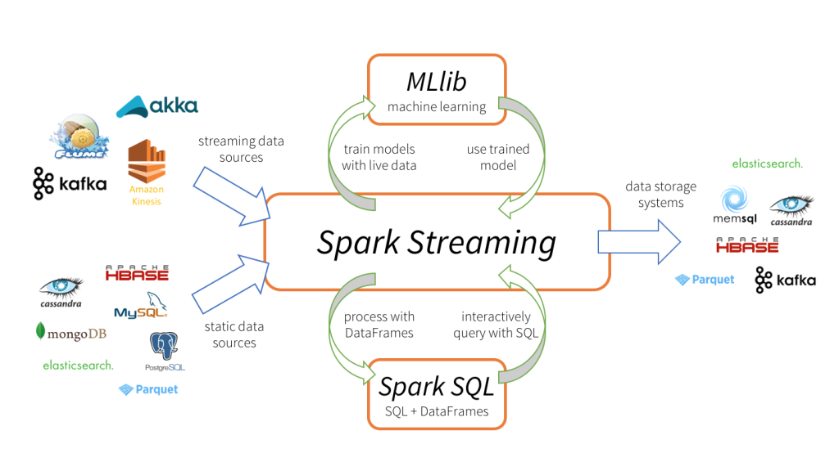
Spark - A data Ecosystem

Slide 13
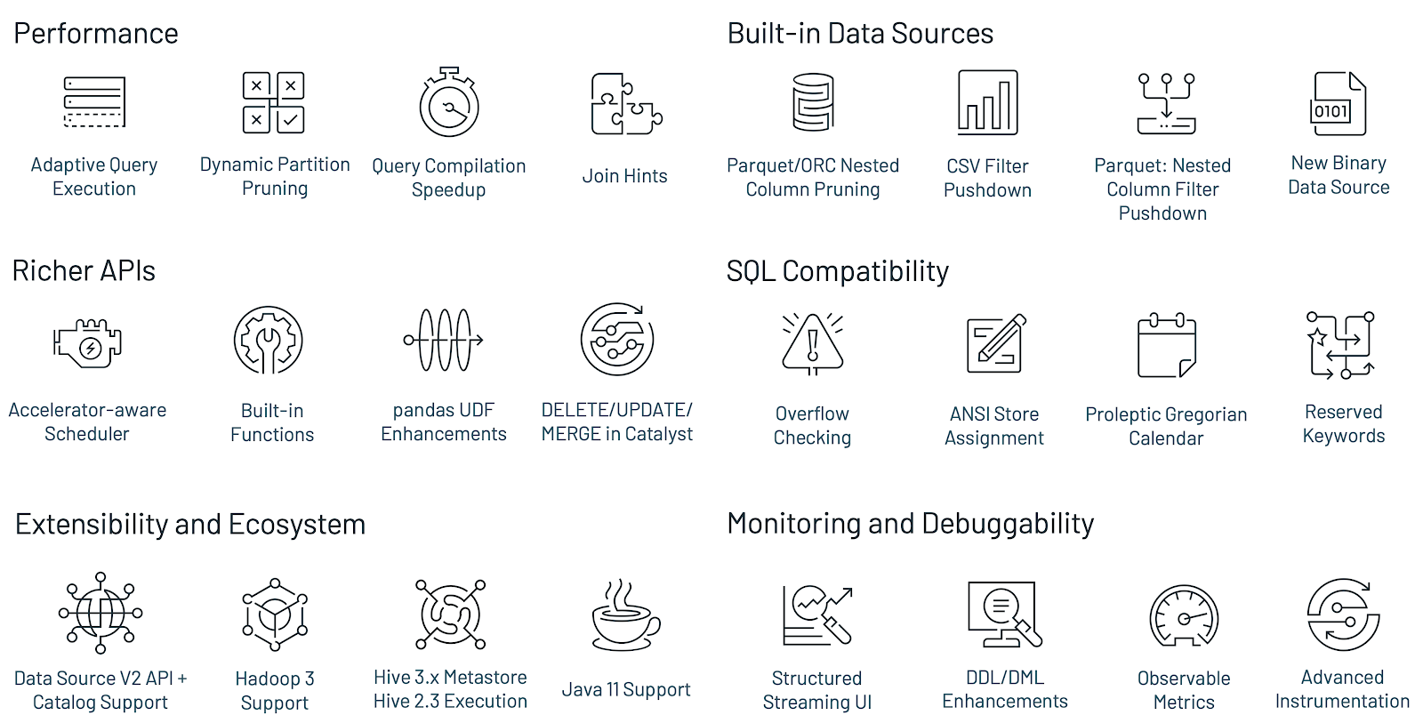
Spark - 3.0

Slide 14
LET’S DO SOME CODE

Slide 15
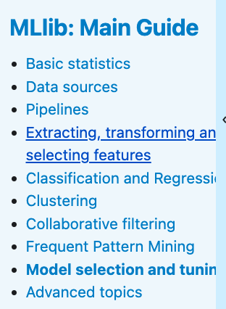
Spark ML
ML Algorithms: common learning algorithms such as classification, regression, clustering, and collaborative filtering
Featurization: feature extraction, transformation, dimensionality reduction, and selection
Pipelines: tools for constructing, evaluating, and tuning ML Pipelines
Persistence: saving and load algorithms, models, and Pipelines
Utilities: linear algebra, statistics, data handling, etc.

Slide 16
SkLearn with Apache Spark
from sklearn import grid_search, datasets
from sklearn.ensemble import RandomForestClassifier
from spark_sklearn import GridSearchCV
digits = datasets.load_digits()
X, y = digits.data, digits.target
param_grid = {"max_depth": [3, None],
"max_features": [1, 3, 10],
"min_samples_split": [1, 3, 10],
"min_samples_leaf": [1, 3, 10],
"bootstrap": [True, False],
"criterion": ["gini", "entropy"],
"n_estimators": [10, 20, 40, 80]}
gs = grid_search.GridSearchCV(RandomForestClassifier(),
param_grid=param_grid)
gs.fit(X, y)
from sklearn import grid_search, datasets
from sklearn.ensemble import RandomForestClassifier
from sklearn.grid_search import GridSearchCV
digits = datasets.load_digits()
X, y = digits.data, digits.target
param_grid = {"max_depth": [3, None],
"max_features": [1, 3, 10],
"min_samples_split": [1, 3, 10],
"min_samples_leaf": [1, 3, 10],
"bootstrap": [True, False],
"criterion": ["gini", "entropy"],
"n_estimators": [10, 20, 40, 80]}
gs = grid_search.GridSearchCV(RandomForestClassifier(),
param_grid=param_grid)
gs.fit(X, y)

Slide 17
Joblib Apache Spark Backend
from sklearn.utils import parallel_backend
from sklearn.model_selection import
cross_val_score
from sklearn import datasets
from sklearn import svm
from joblibspark import register_spark
register_spark() # register spark backend
iris = datasets.load_iris()
clf = svm.SVC(kernel='linear', C=1)
with parallel_backend('spark', n_jobs=3):
scores = cross_val_score(clf, iris.data, iris.target, cv=5)
print(scores)
from sklearn.feature_extraction import
FeatureHasher
h = FeatureHasher(n_features=10)
with parallel_backend('spark', n_jobs=3):
# This won't run parallelly on spark, it will still run locally.
h.transform(...)
from sklearn import linear_model
regr = linear_model.LinearRegression()
regr.fit(X_train, y_train)
with parallel_backend('spark', n_jobs=3):
# This won't run parallelly on spark, it will still run locally.
regr.predict(diabetes_X_test)

Slide 18
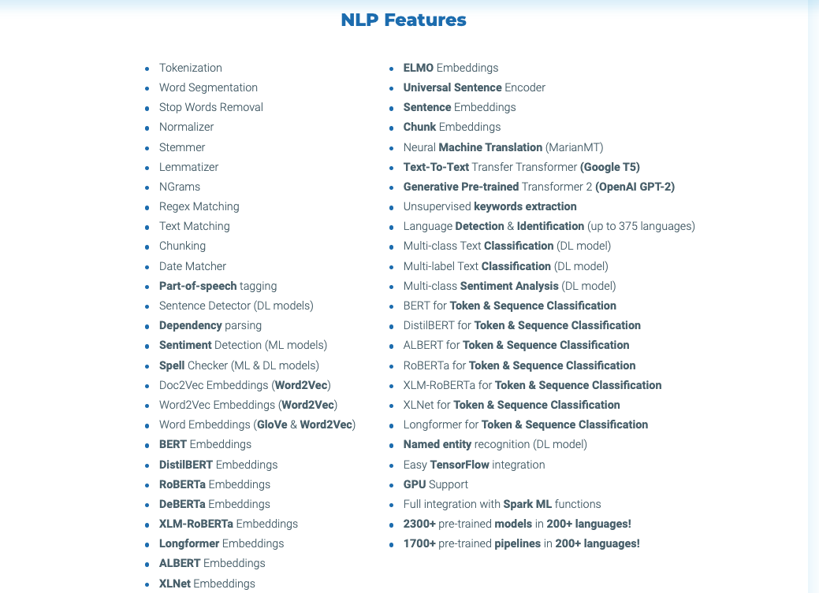
Spark NLP Features

Slide 19
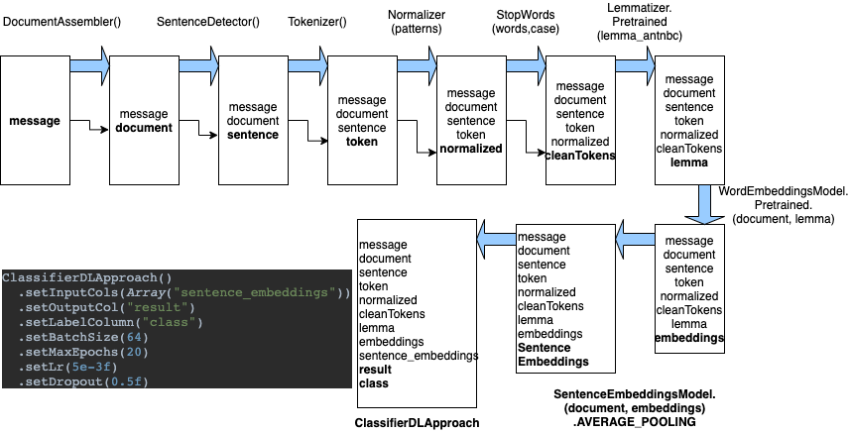
Pipelines- Classification with word and Sentence Embeddings

Slide 20
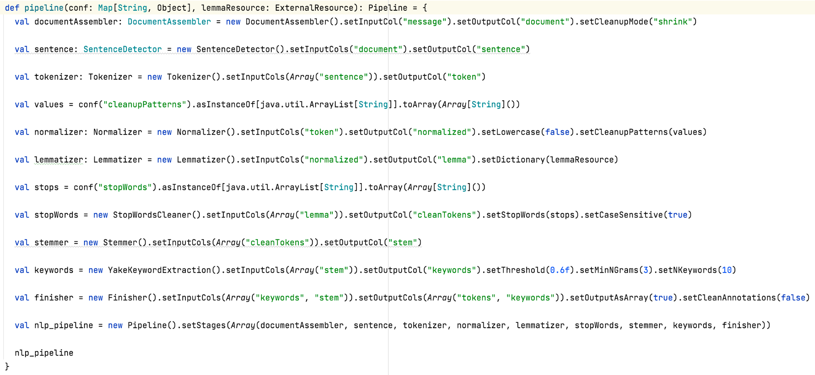
Pipeline

Slide 21
Logistic Regression
Let’s Code.

Slide 22
Naive Bayes
Let’s Code.

Slide 23
Questions?

